Slide 1
Gravitational Waves
Sam Grobelny, Sacha Wible, Wentao Zhong

Slide 2
Motivations
Methods + Assumptions
By studying black hole mergers via gravitational waves, we can figure out the distance from Earth. Comparing this to redshift of the light from these events allows us to better understand the universe's expansion.
By using gravitational wave data collected from LIGO we should be able to calculate the masses of the two black holes that merged in order to cause the wave.
Chirp Mass = (c^3 * peak frequency)/ (pi * G)

Slide 3
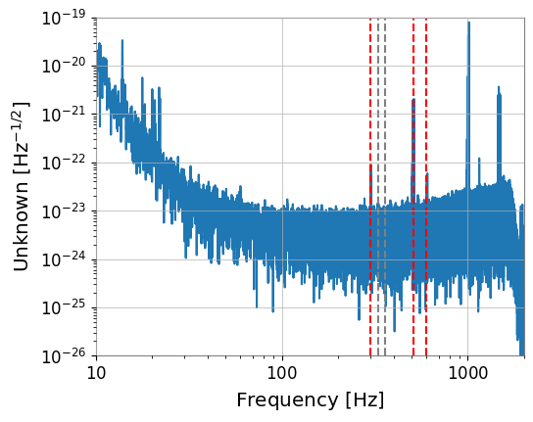
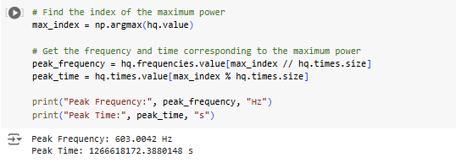
Fast Fourier transform - GW200224_222234
Notes:
By transforming the data into a frequency domain, its easier to tell which frequencies dominate the sample and how they vary over time, as well as improving the Signal to Noise ratio

Slide 4
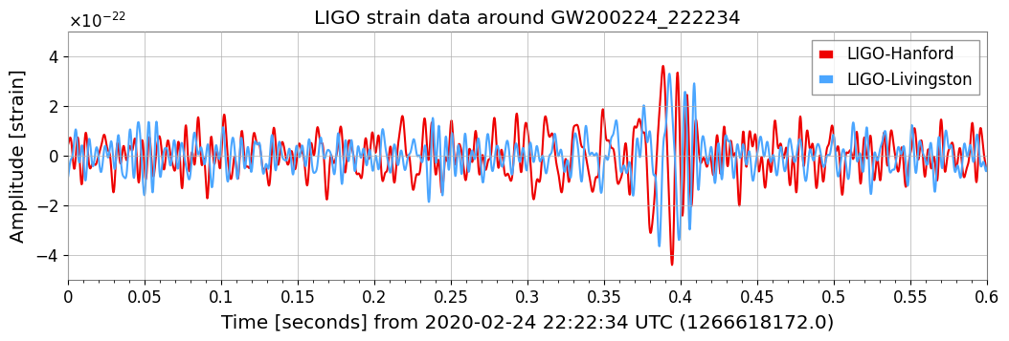
Notes:
Strain is the change in distance caused by the gravitational wave

Slide 5
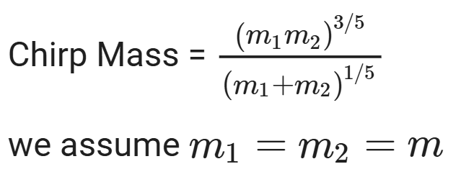
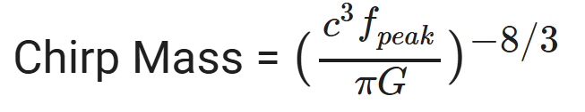
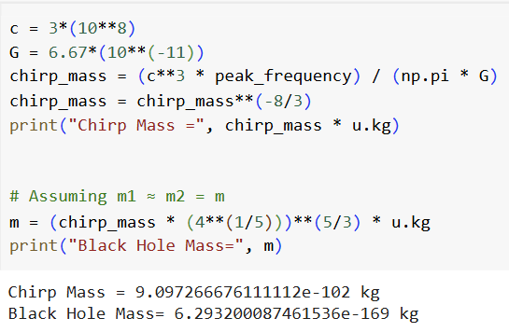
Chirp Mass
We can use the peak frequency to estimate the chirp mass, which is then a sum of the two masses of the black holes. Because we are operating with just gwpy, we will assume that the two black holes are the same size.
Using these formulas we find that both the chirp mass and the black hole mass are comically small. This is because my code is wrong.

Slide 6
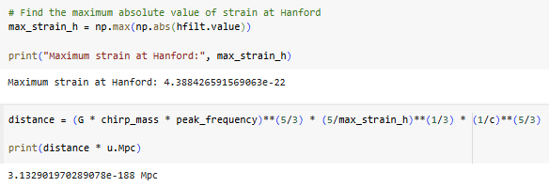

Distance and Energy Lost
We can use the chirp mass, peak frequency and the maximum strain to estimate the distance between the black holes and Earth.
Notice how the distance and energy lost is so small. This is because my code is wrong.

Slide 7
Conclusion
AI Acknowledgement
Black holes are big.
I used AI to figure out how to get the chirp mass from the peak frequency.

